Slide 1
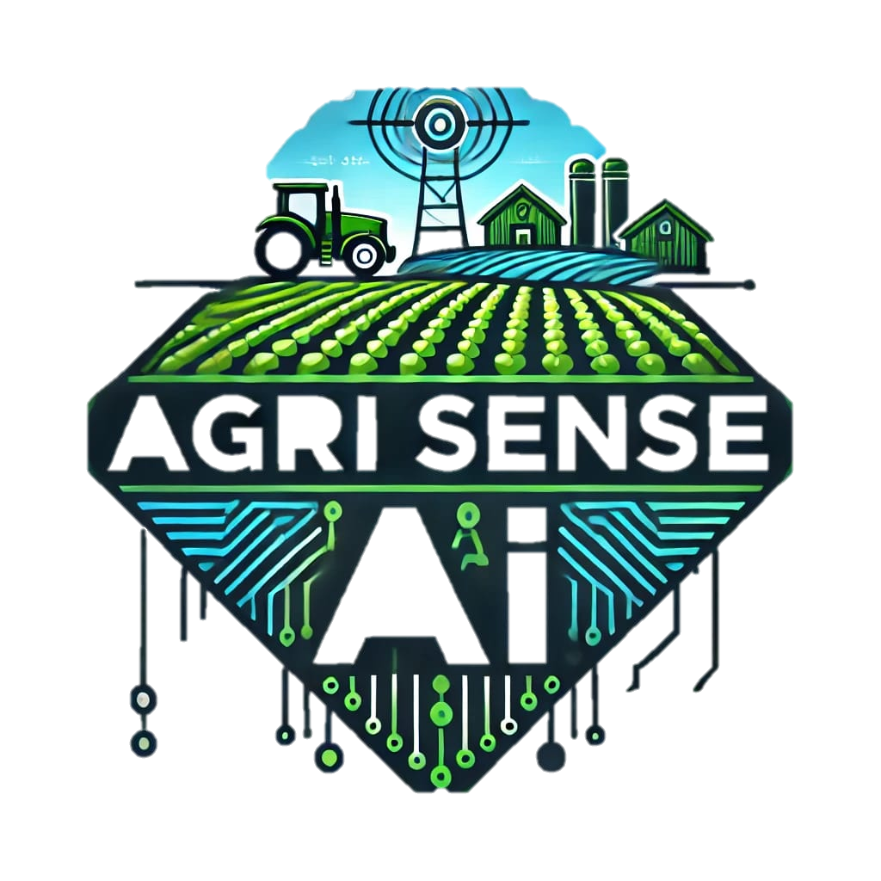
AgriSense AI

Slide 2
Introduction: AgriSenseAI – AI-Powered Precision Farming
📌 Agriculture is the backbone of the economy, but farmers face challenges such as inefficient resource use, climate unpredictability, and declining yields.
📌 Traditional Farming relies on experience rather than real-time data, leading to inefficiencies.
📌 AgriSenseAI is an AI-powered precision farming solution integrating IoT, AI, and Edge Computing to optimize farming operations.
📌 Key Benefits:
🌾 Smart Soil Monitoring – Real-time tracking of moisture, pH, and nutrients.
🦠 AI-Based Pest & Disease Detection – Early alerts using Edge AI cameras.
💧 Automated Irrigation – AI-driven water optimization to reduce waste.
🌤 Weather Prediction & Yield Forecasting – AI models improve planning.
📊 Smart Marketplace Integration – AI-driven pricing and direct farmer-to-buyer connections.
📌 Mission: Enhancing yield, reducing resource waste, and empowering farmers with technology-driven insights.
Notes:
### **Slide Notes for Introduction – AgriSenseAI**
#### **Slide Title: AgriSenseAI – AI-Powered Precision Farming**
---
### **1. Agriculture: Backbone of the Economy**
- Agriculture plays a **crucial role in food production and economic growth**, especially in countries like **India** where a majority of the population depends on farming for livelihood.
- Despite technological advancements, **farmers still struggle with unpredictable weather, soil degradation, and resource inefficiencies** that impact yield and profitability.
- Example: **A wheat farmer in Punjab** faces **water wastage due to inefficient irrigation**, leading to reduced productivity.
---
### **2. Traditional Farming Limitations**
- Most farmers rely on **experience-based decision-making** rather than data-driven insights.
- Issues like **over-irrigation, late pest detection, and inaccurate weather predictions** lead to reduced efficiency and financial loss.
- Example: **A rice farmer in Tamil Nadu** applies **fertilizers based on seasonal patterns** instead of **real-time soil health data**, which can lead to nutrient imbalances.
---
### **3. Introducing AgriSenseAI: Smart Farming for the Future**
- **AgriSenseAI** is an **AI-powered, IoT-driven smart farming solution** designed to enhance **crop monitoring, resource utilization, and decision-making** in real time.
- It combines **Edge AI, IoT sensors, and predictive analytics** to optimize farming processes, **ensuring sustainability and higher yields**.
---
### **4. Key Benefits of AgriSenseAI**
✅ **Smart Soil Monitoring**
- **IoT sensors** track **moisture, pH, and nutrient levels** in real time.
- Example: A **potato farmer in Gujarat** gets **automatic alerts** if the soil lacks nitrogen, prompting timely fertilization.
✅ **AI-Based Pest & Disease Detection**
- **Edge AI-powered cameras** continuously scan crops for signs of **pests or diseases**.
- Example: A **mango orchard in Maharashtra** detects **fungal infection early**, reducing fruit loss by 30%.
✅ **Automated Irrigation System**
- **AI optimizes water distribution**, ensuring **efficient irrigation** based on soil needs.
- Example: A **sugarcane farm in Uttar Pradesh** reduces **water usage by 40%** using AI-driven irrigation.
✅ **Weather Prediction & Yield Forecasting**
- **AI-based models analyze weather patterns** to help farmers plan harvesting and planting.
- Example: A **tea plantation in Assam** adjusts harvest schedules **before heavy rainfall**, preventing crop damage.
✅ **Smart Marketplace Integration**
- Farmers receive **AI-driven price predictions** and connect directly with buyers to **maximize profits**.
- Example: A **tomato farmer in Karnataka** sells produce **at peak price**, avoiding losses due to sudden price drops.
---
### **5. Mission of AgriSenseAI**
🎯 **To empower farmers with AI & IoT technology for sustainable, high-yield, and data-driven agriculture.**
- Helping farmers make **smarter decisions** with **real-time insights**.
- **Reducing resource wastage**, ensuring **better financial returns**.
- **Building a resilient farming ecosystem** with **technology-driven solutions**.
---
### **Final Thought**
- **AgriSenseAI is the future of farming** – bringing **innovation, sustainability, and efficiency** to agriculture.
- **Are we ready to revolutionize agriculture together?** 🚀🌱
---
This **slide note** provides **detailed explanations with relatable examples**, ensuring your **presentation is impactful and easy to understand**. Let me know if you need any **refinements**! 🎤📊

Slide 3
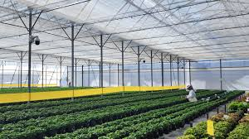
Problem Statement – Challenges in Traditional Farming
1️⃣ Inefficient Resource Utilization
🌊 Overuse of water & fertilizers leads to waste and soil degradation.
🚱 Groundwater depletion due to excessive irrigation.
2️⃣ Lack of Real-Time Soil Health Monitoring
🌱 Farmers apply fertilizers without precise data, causing nutrient imbalance.
3️⃣ Late Detection of Pests & Crop Diseases
🐛 Pests and diseases go unnoticed until visible damage occurs.
4️⃣ Unpredictable Climate Conditions
⛈️ Extreme weather events impact crop cycles & yield.
5️⃣ Market Price Fluctuations & Financial Losses
📉 Farmers lack real-time pricing insights, leading to low profits.
6️⃣ Expensive & Complex AgriTech Solutions
💰 Current solutions are costly & require technical expertise, limiting adoption.
Notes:
problem statement
🔹 Conclusion: Why AgriSenseAI?
🚀 AgriSenseAI solves these problems through AI & IoT-based smart farming:
✅ Water & resource optimization
✅ Real-time soil & crop health monitoring
✅ AI-based pest detection & early intervention
✅ Weather forecasting & yield prediction
✅ Smart marketplace integration for fair pricing
🌿 AgriSenseAI transforms farming into a data-driven, efficient, and profitable system!

Slide 4
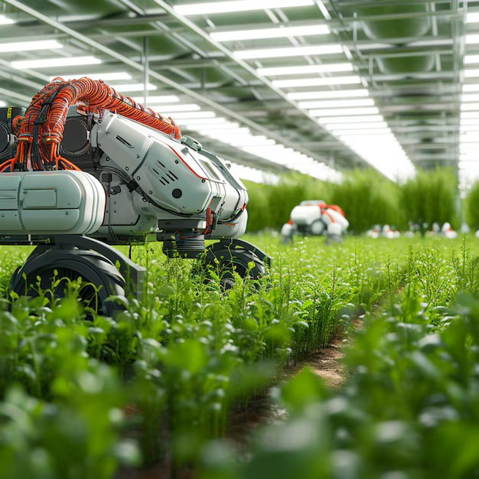
Target Audience – Who Benefits from AgriSenseAI?
🌾 1️⃣ Small & Large-Scale Farmers
📌 Improve crop yields with AI-powered insights.
📌 Reduce costs by optimizing water, fertilizers, and pesticides.
📌 Prevent losses with early disease detection.
🏢 2️⃣ AgriTech Companies & Governments
📌 Enhance national food security with data-driven agriculture.
📌 Enable digital farming adoption for large-scale rural initiatives.
📌 Develop smart agricultural policies with real-time analytics.
🏭 3️⃣ Food Processing & Supply Chain Companies
📌 Ensure consistent quality & reliable yield predictions.
📌 Optimize supply chain logistics with accurate harvest forecasting.
📌 Reduce wastage through better storage & distribution planning.
💰 4️⃣ Agri-FinTech & Insurance Providers
📌 Accurate risk assessment for farm loans & crop insurance.
📌 Use AI-driven yield prediction for insurance premium calculations.
📌 Minimize financial risk with real-time farm health monitoring.
Notes:
Conclusion: Why These Stakeholders Matter?🚀 AgriSenseAI creates value across the entire agricultural ecosystem:✅ Farmers boost productivity & profits.✅ AgriTech & Governments enhance food security & policies.✅ Food supply chains reduce waste & optimize logistics.✅ FinTech & Insurers lower risks & improve financial security.

Slide 5
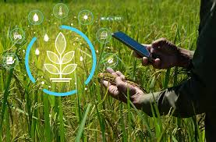
AgriSense Smart Farming Platform
Smart Soil Monitoring with IoT Sensors
AI-Based Pest & Disease Detection
Automated Irrigation System
AI-Driven Weather & Yield Forecasting
Smart Marketplace Integration
Drone-Based Crop Monitoring
Notes:
🔹 Conclusion: Why AgriSenseAI?🚀 A complete AI-driven solution transforming agriculture with:
✅ Real-time soil & crop health monitoring.
✅ Automated irrigation & pest control.
✅ AI-powered weather predictions & yield forecasting.
✅ Market insights for better pricing & profits.🌿 AgriSenseAI: The Future of Smart Farming!How to Present the Slide? (Speaker Notes for You)Introduce the problem – Farmers face issues like resource wastage, late pest detection, unpredictable weather, and price fluctuations.Explain the AI-driven solutions in simple terms – Describe each feature with real-world examples.Highlight the impact – Emphasize how AgriSenseAI helps farmers save resources, improve yields, and maximize profits.Summarize the big picture – AgriSenseAI isn’t just a tool; it’s a revolution in smart farming!

Slide 6
Competitive Landscape – AgriSenseAI vs. Existing Solutions
🔍 1️⃣ The Need for a Smarter Farming Solution
📌 Traditional farming lacks real-time insights, leading to inefficiencies.
📌 Existing AgriTech solutions are either too expensive or lack AI-driven automation.
📈 2️⃣ Why AgriSenseAI Stands Out?
🚀 Comprehensive AI-Powered System – Combines AI, IoT, and Market Insights in one platform.
🚀 Cost-Effective – More affordable than competitors like CropX & Taranis.
🚀 All-in-One Solution – Handles soil health, irrigation, disease detection, and price optimization.
🚀 Scalable for All Farmers – Works for small, medium, and large-scale farms.
🚀 AgriSenseAI bridges the gap with an affordable, AI-powered precision farming platform.
Notes:
🔹 Conclusion: Why AgriSenseAI?🚀 A complete AI-driven solution transforming agriculture with:✅ Real-time soil & crop health monitoring.✅ Automated irrigation & pest control.✅ AI-powered weather predictions & yield forecasting.✅ Market insights for better pricing & profits.🌿 AgriSenseAI: The Future of Smart Farming!How to Present the Slide? (Speaker Notes for You)Introduce the problem – Farmers face issues like resource wastage, late pest detection, unpredictable weather, and price fluctuations.Explain the AI-driven solutions in simple terms – Describe each feature with real-world examples.Highlight the impact – Emphasize how AgriSenseAI helps farmers save resources, improve yields, and maximize profits.Summarize the big picture – AgriSenseAI isn’t just a tool; it’s a revolution in smart farming!

Slide 7
Competitor Table
Feature | AgriSense AI | CropX(Israel) | Taranis(USA) | Traditional Farming
AI-Powered Disease Detection | ✅yes | ✅yes | ✅yes | ❌No
Smart MarketPLace Integration | ✅yes | ✅yes | ❌no | ❌No
Real-Time IoT Monitoring | ✅yes | ✅yes | ❌no | ❌No
Automated Irrigation | ✅yes | ❌No | ✅yes | ❌No
AI-Driven Yield Forecasting | ✅yes | ❌No | ❌No | ❌No
Integrated Marketplace | ✅yes | ❌No | ✅yes | ❌No
Refernces |  | https://israelagri.com/advanced-crop-management-app-saves-water/ | https://www.taranis.com/ | Followed by Indian farmers

Slide 8
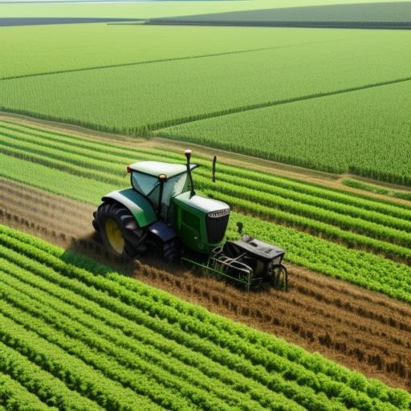
Revenue Model – AgriSenseAI (India-Based Approach)
💰 1️⃣ Hardware Sales (One-Time Purchase)
📌 IoT Sensors, Edge AI Cameras, and Automated Irrigation Controllers
📌 Farmers can buy affordable IoT kits customized for different crops & farm sizes.
📌 Approximate Pricing: ₹5,000 – ₹25,000 per kit (based on farm size & features).
📡 2️⃣ Subscription Model (SaaS) – AI-Powered Insights
📌 Monthly/Annual Plans for Real-Time AI Analytics & Recommendations
📌 Farmers receive personalized soil reports, weather predictions & yield forecasts.
📌 Approximate Pricing: ₹299/month (Basic) | ₹999/month (Advanced) | ₹1,999/month
📊 3️⃣ Premium Features (Add-On Services)
📌 Drone-Based Crop Monitoring (For Large Farms) – ₹2,500 per drone scan.
📌 Custom AI Models for precision farming (₹5,000 per model upgrade).
📌 Blockchain-Based Smart Marketplace Access for direct sales – ₹1,500/year.
Notes:
Conclusion: Scalable & Profitable Revenue Model🚀 Affordable pricing ensures adoption by small & large farmers.🚀 Subscription-based AI insights create continuous revenue.🚀 Enterprise partnerships with governments & AgriTech companies expand market reach.🚀 Marketplace transactions & premium features enhance profitability.🌿 AgriSenseAI: Transforming Indian Agriculture with AI & IoT!

Slide 9
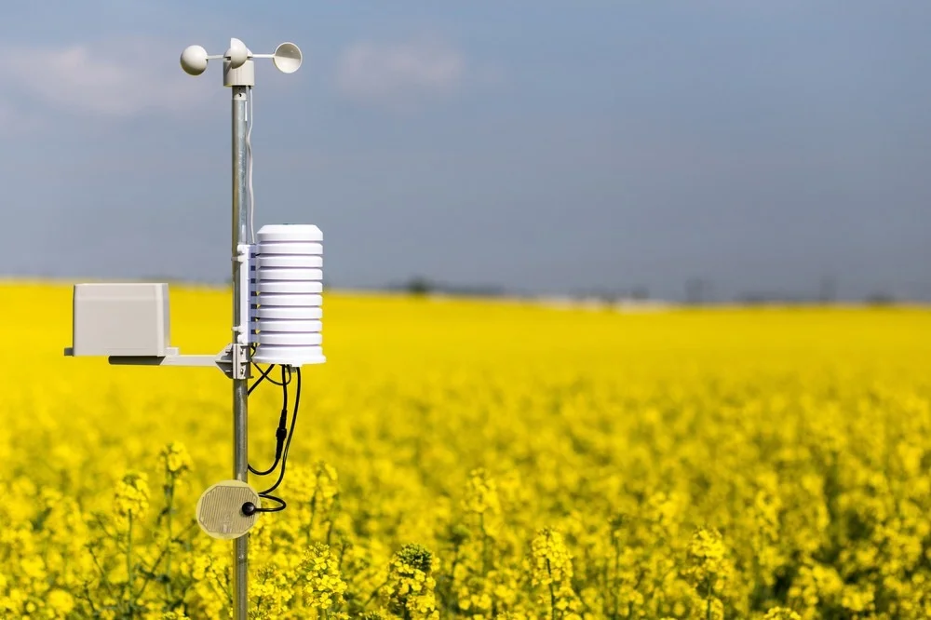
🏢 4️⃣ Enterprise Licensing (B2B & Government Collaborations)
📌 State Government & AgriTech Partnerships for Digital Agriculture Programs.
📌 Bulk Licensing for Agri-FinTech & Crop Insurance Companies to use AI data.
📌 Custom Integration for Food Supply Chain & Agri-Research Institutions.
📌 Approximate Revenue: ₹10 lakh – ₹50 lakh per contract.
🌍 5️⃣ Commission-Based Revenue from Marketplace Transactions
📌 Farmers can sell directly to buyers via AgriSenseAI’s digital platform.
📌 AgriSenseAI earns a 2% commission per transaction.
📌 Approximate Pricing: ₹500 – ₹5,000 per transaction (varies by crop & volume).

Slide 10
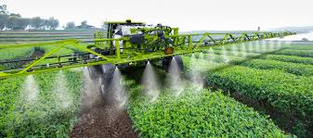
Technology Stack
IoT Sensors & Edge AI: Arduino, Raspberry Pi, NVIDIA Jetson.
AI & Computer Vision: TensorFlow, PyTorch, OpenCV.
Cloud & Edge Computing: AWS IoT, Google Cloud AI, Azure IoT Hub.
Mobile & Web: React.js, Flutter, Node.js, Firebase.
Connectivity & Network Communication Protocols: MQTT, LoRaWAN, NB-IoT for real-time sensor data transfer.
Blockchain Platforms: Hyperledger Fabric, Ethereum Smart Contracts
Supply Chain Transparency: Track farm-to-market logistics for authenticity.
Notes:
🔹 Conclusion: Why AgriSenseAI’s Tech Stack is Future-Ready?🚀 IoT + AI + Cloud Computing → Real-time farming insights.🚀 Edge AI Processing → Fast on-site analysis without internet dependency.🚀 Blockchain & Smart Contracts → Secure transactions & fair pricing for farmers.🚀 Scalable Architecture → Works for small, medium & large farms across India.🌿 AgriSenseAI: Powering the Future of Indian Smart Agriculture!

Slide 11
Budget Allocation for AgriSenseAI IoT Sensor Kit
📊 Total Budget: ₹50 Lakhs for IoT Sensor Kit Development
📌 Focus on affordable, scalable, and high-precision smart farming solutions. 📌 Covers hardware, AI development, cloud infrastructure, manufacturing & marketing.
💰 Budget Breakdown (Tabular Format)
Category | Allocation (%) | Approximate Budget (₹ in Lakhs) | Details
Research & Development | 30% | ₹15 Lakhs | AI model training, IoT sensor optimization, AI-powered soil analysis.
Hardware & Manufacturing | 40% | ₹20 Lakhs | Production of IoT sensors (moisture, pH, temperature, NPK), Edge AI cameras.
Cloud & Mobile App Development | 15% | ₹7.5 Lakhs | Cloud infrastructure, mobile app for real-time monitoring.
Marketing & Farmer Outreach | 10% | ₹5 Lakhs | Pilot programs, social media & Krishi influencer marketing.
Testing & Deployment | 5% | ₹2.5 Lakhs | Sensor testing, quality assurance, field trials in different regions.
Total Budget | 100% | ₹50 Lakhs | Comprehensive IoT-based smart farming product development.

Slide 12
Deployment Plan – AgriSenseAI in Indian Agriculture
📍 1️⃣ Phase-Wise Deployment Strategy
📌 Step-by-step rollout to ensure scalability, farmer adoption, and government partnerships.
📌 Focus on pilot testing, regional expansion & nationwide scaling.
📅 2️⃣ Deployment Approximate Timeline (12-Month Plan)Phase Duration Key Activities:
Phase 1: Pilot Testing 0-3 Months
📌 Deploy IoT sensors & AI models in 10 farms across Punjab, Maharashtra, UP.
📌 Collect real-time data for model improvement.
📌 Train early adopters & Krishi Influencers. Phase 2: Early Expansion 4-6 Months
📌 Expand to 100+ farms in Andhra Pradesh, Tamil Nadu, Gujarat.
📌 Partner with Krishi Vigyan Kendras (KVKs) & agricultural universities.
📌 Refine mobile app based on farmer feedback. Phase 3: Government & B2B Partnerships 7-9 Months
📌 Collaborate with PM-KISAN & state agriculture departments.
📌 Integrate AgriSenseAI with farm loan & insurance providers.
📌 Offer subsidized IoT kits via government initiatives. Phase 4: Nationwide Scaling 10-12 Months
📌 Scale to 10,000+ farms with regional AgriTech distributors.
📌 Partner with FPOs (Farmer Producer Organizations) for mass adoption.
📌 Launch blockchain-based Smart Marketplace for direct farmer-to-buyer sales
Notes:
Conclusion: Scalable & Sustainable Deployment🚀 Phase-wise expansion ensures steady adoption & data-driven refinements.🚀 Strategic partnerships with government, AgriTech firms & Krishi influencers.🚀 FPO & Smart Marketplace integration for long-term impact.🌿 AgriSenseAI: Bringing AI-Powered Smart Farming to Indian Fields! 🚜📊

Slide 13
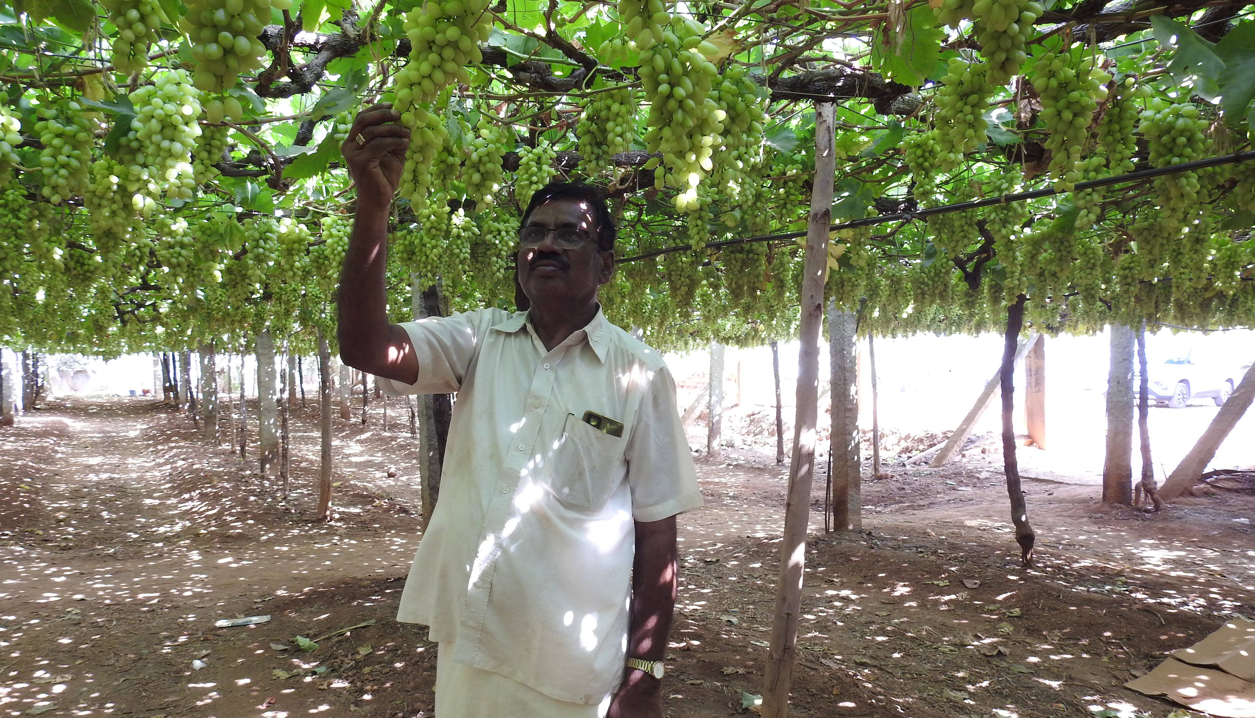
🌍 3️⃣ Target Deployment Regions
📌 North India: Punjab, Haryana, Uttar Pradesh – High-value crops like wheat, paddy.
📌 South India: Tamil Nadu, Andhra Pradesh, Karnataka – Strong AgriTech adoption.
📌 West India: Maharashtra, Gujarat, Rajasthan – Diverse farming practices & AI potential.
📌 East India: West Bengal, Assam, Odisha – Emerging smart agriculture market.
🤝 4️⃣ Deployment Partners & Collaborations
📌 Agricultural Universities – Research & field trials.
📌 Krishi Vigyan Kendras (KVKs) – On-ground farmer training.
📌 State Government Schemes (PM-KISAN, Digital Agriculture Mission) – Subsidized adoption.
📌 Agri-FinTech & Insurance Companies – Smart loan risk assessments.

Slide 14
THANK YOU!!
Name of the company: AGRISENSE AI
Email: sathwikamacha@gmail.com
manognavemulapalli09@gmail.com
Cell Number: 804675706 ; 8332059027

